Slide 1

De picosegundos a microsegundos, el uso de las simulaciones computacionales para hacer preguntas de bioquímica.
Lenin dominguez-ramirez
Centro de Investigaciones Biomedicas
De Oriente - Imss

Slide 2
Esta platica esta disponible aqui

Slide 3
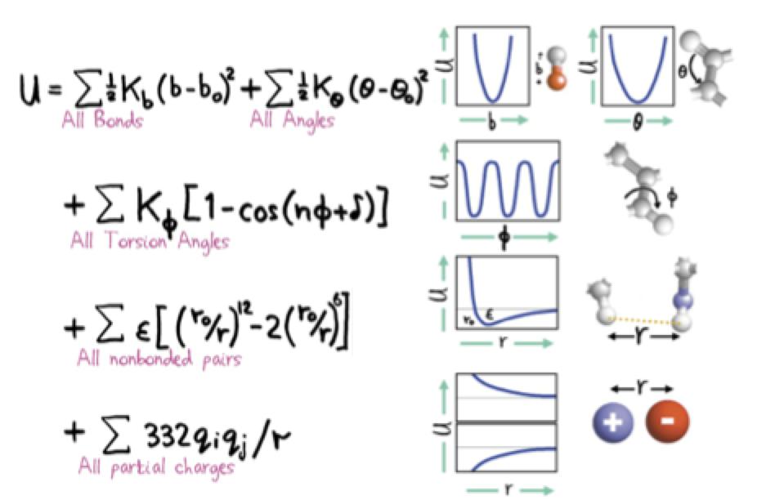
Intro

Slide 4

Premio nobel 2013, Martin Karplus

Slide 5
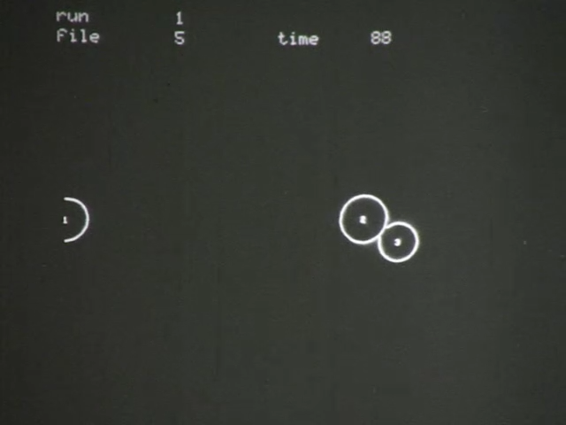
H+H₂ simulations (1965)

Slide 6
Time scale
1 s
0.001 s (milliseconds)
0.000001s (microseconds)
0.000000001 s (nanoseconds)
0.000000000001 s (picoseconds)
0.00000000000000.1 s (femptoseconds)

Slide 7
Karplus:

Slide 8
Time scale
1 s ?
0.001 s (milliseconds) With a large GPU cluster or coarse-grain
0.000001s (microseconds) Today with GPU
0.000000001 s (nanoseconds) 20 years ago
0.000000000001 s (picoseconds)
0.000000000000001 s (femptoseconds) 50 years ago.

Slide 9
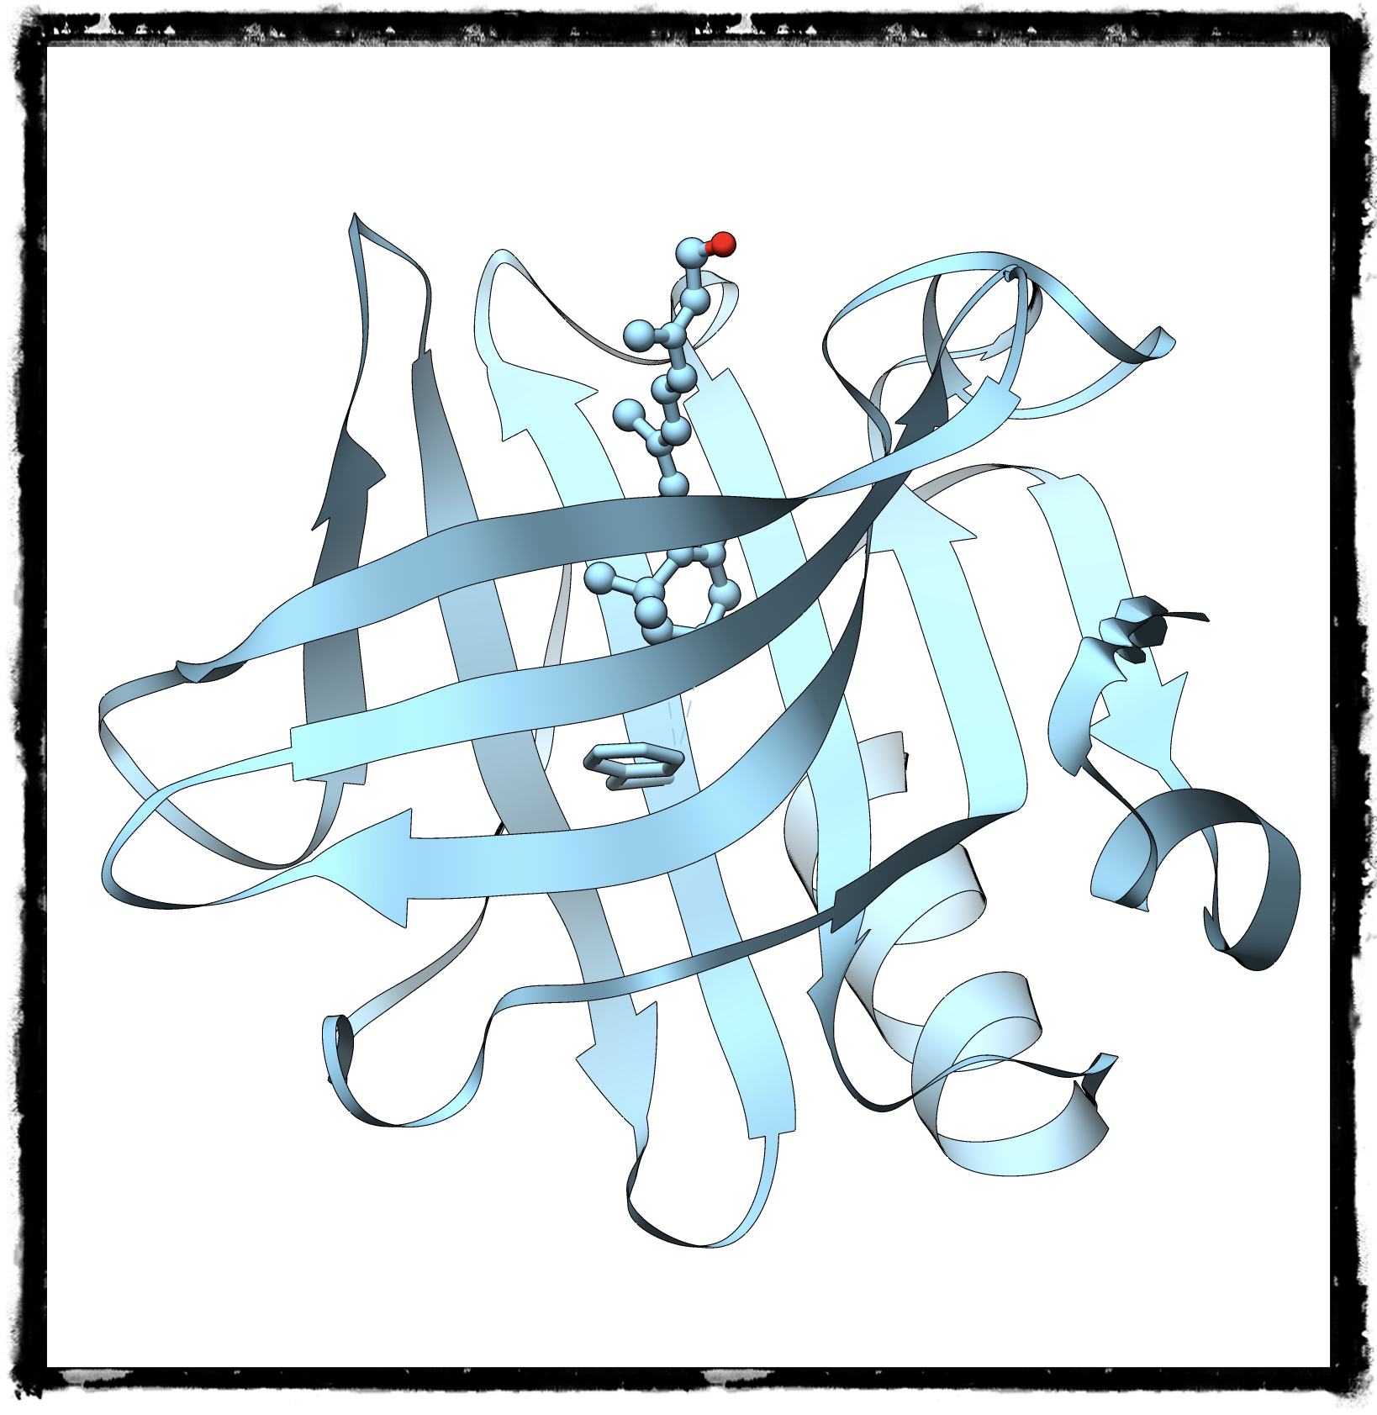
Beta-lactoglobulin from Bos Taurus
Small 162 residue protein.
All beta protein.
Binds fatty acids and retinol/retinoic acid.
Very hydrophobic binding site.
Many XRD structures with several different ligands.

Slide 10
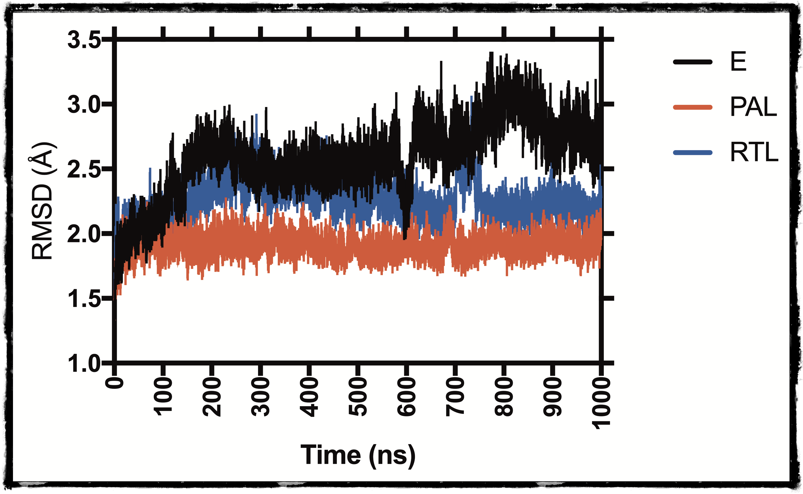
RMSD

Slide 11
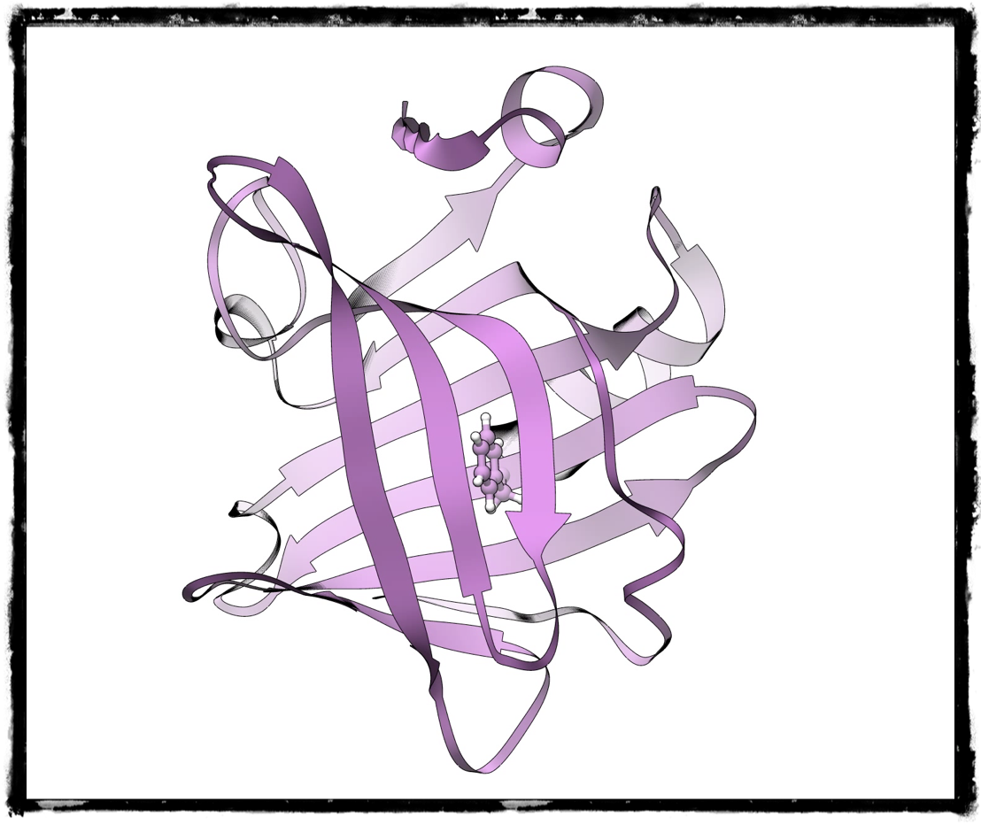
Two possible ”reaction” coordinates
Loop closure defined as the distance between two centers of mass.
Distance between the center of mass of PHE105 and the ligand.

Slide 12
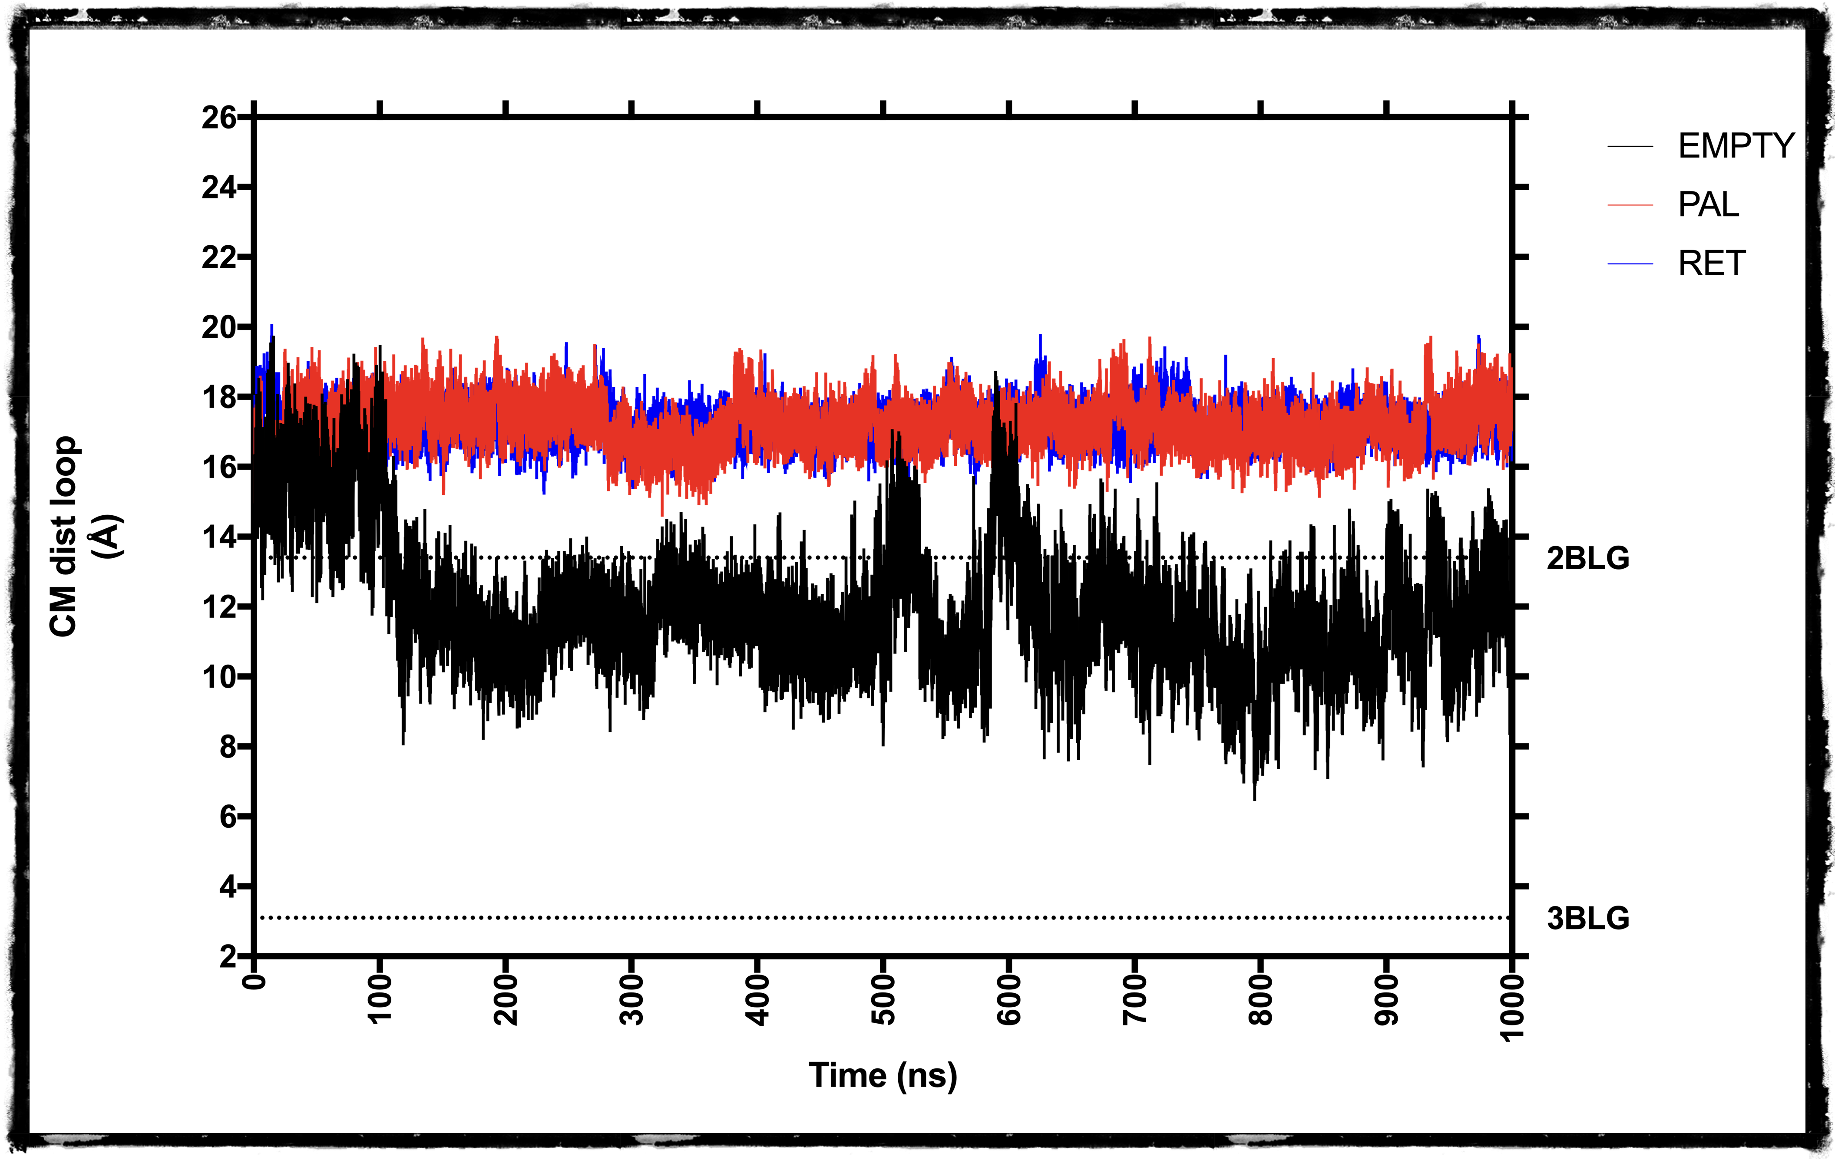
Loop Closure

Slide 13
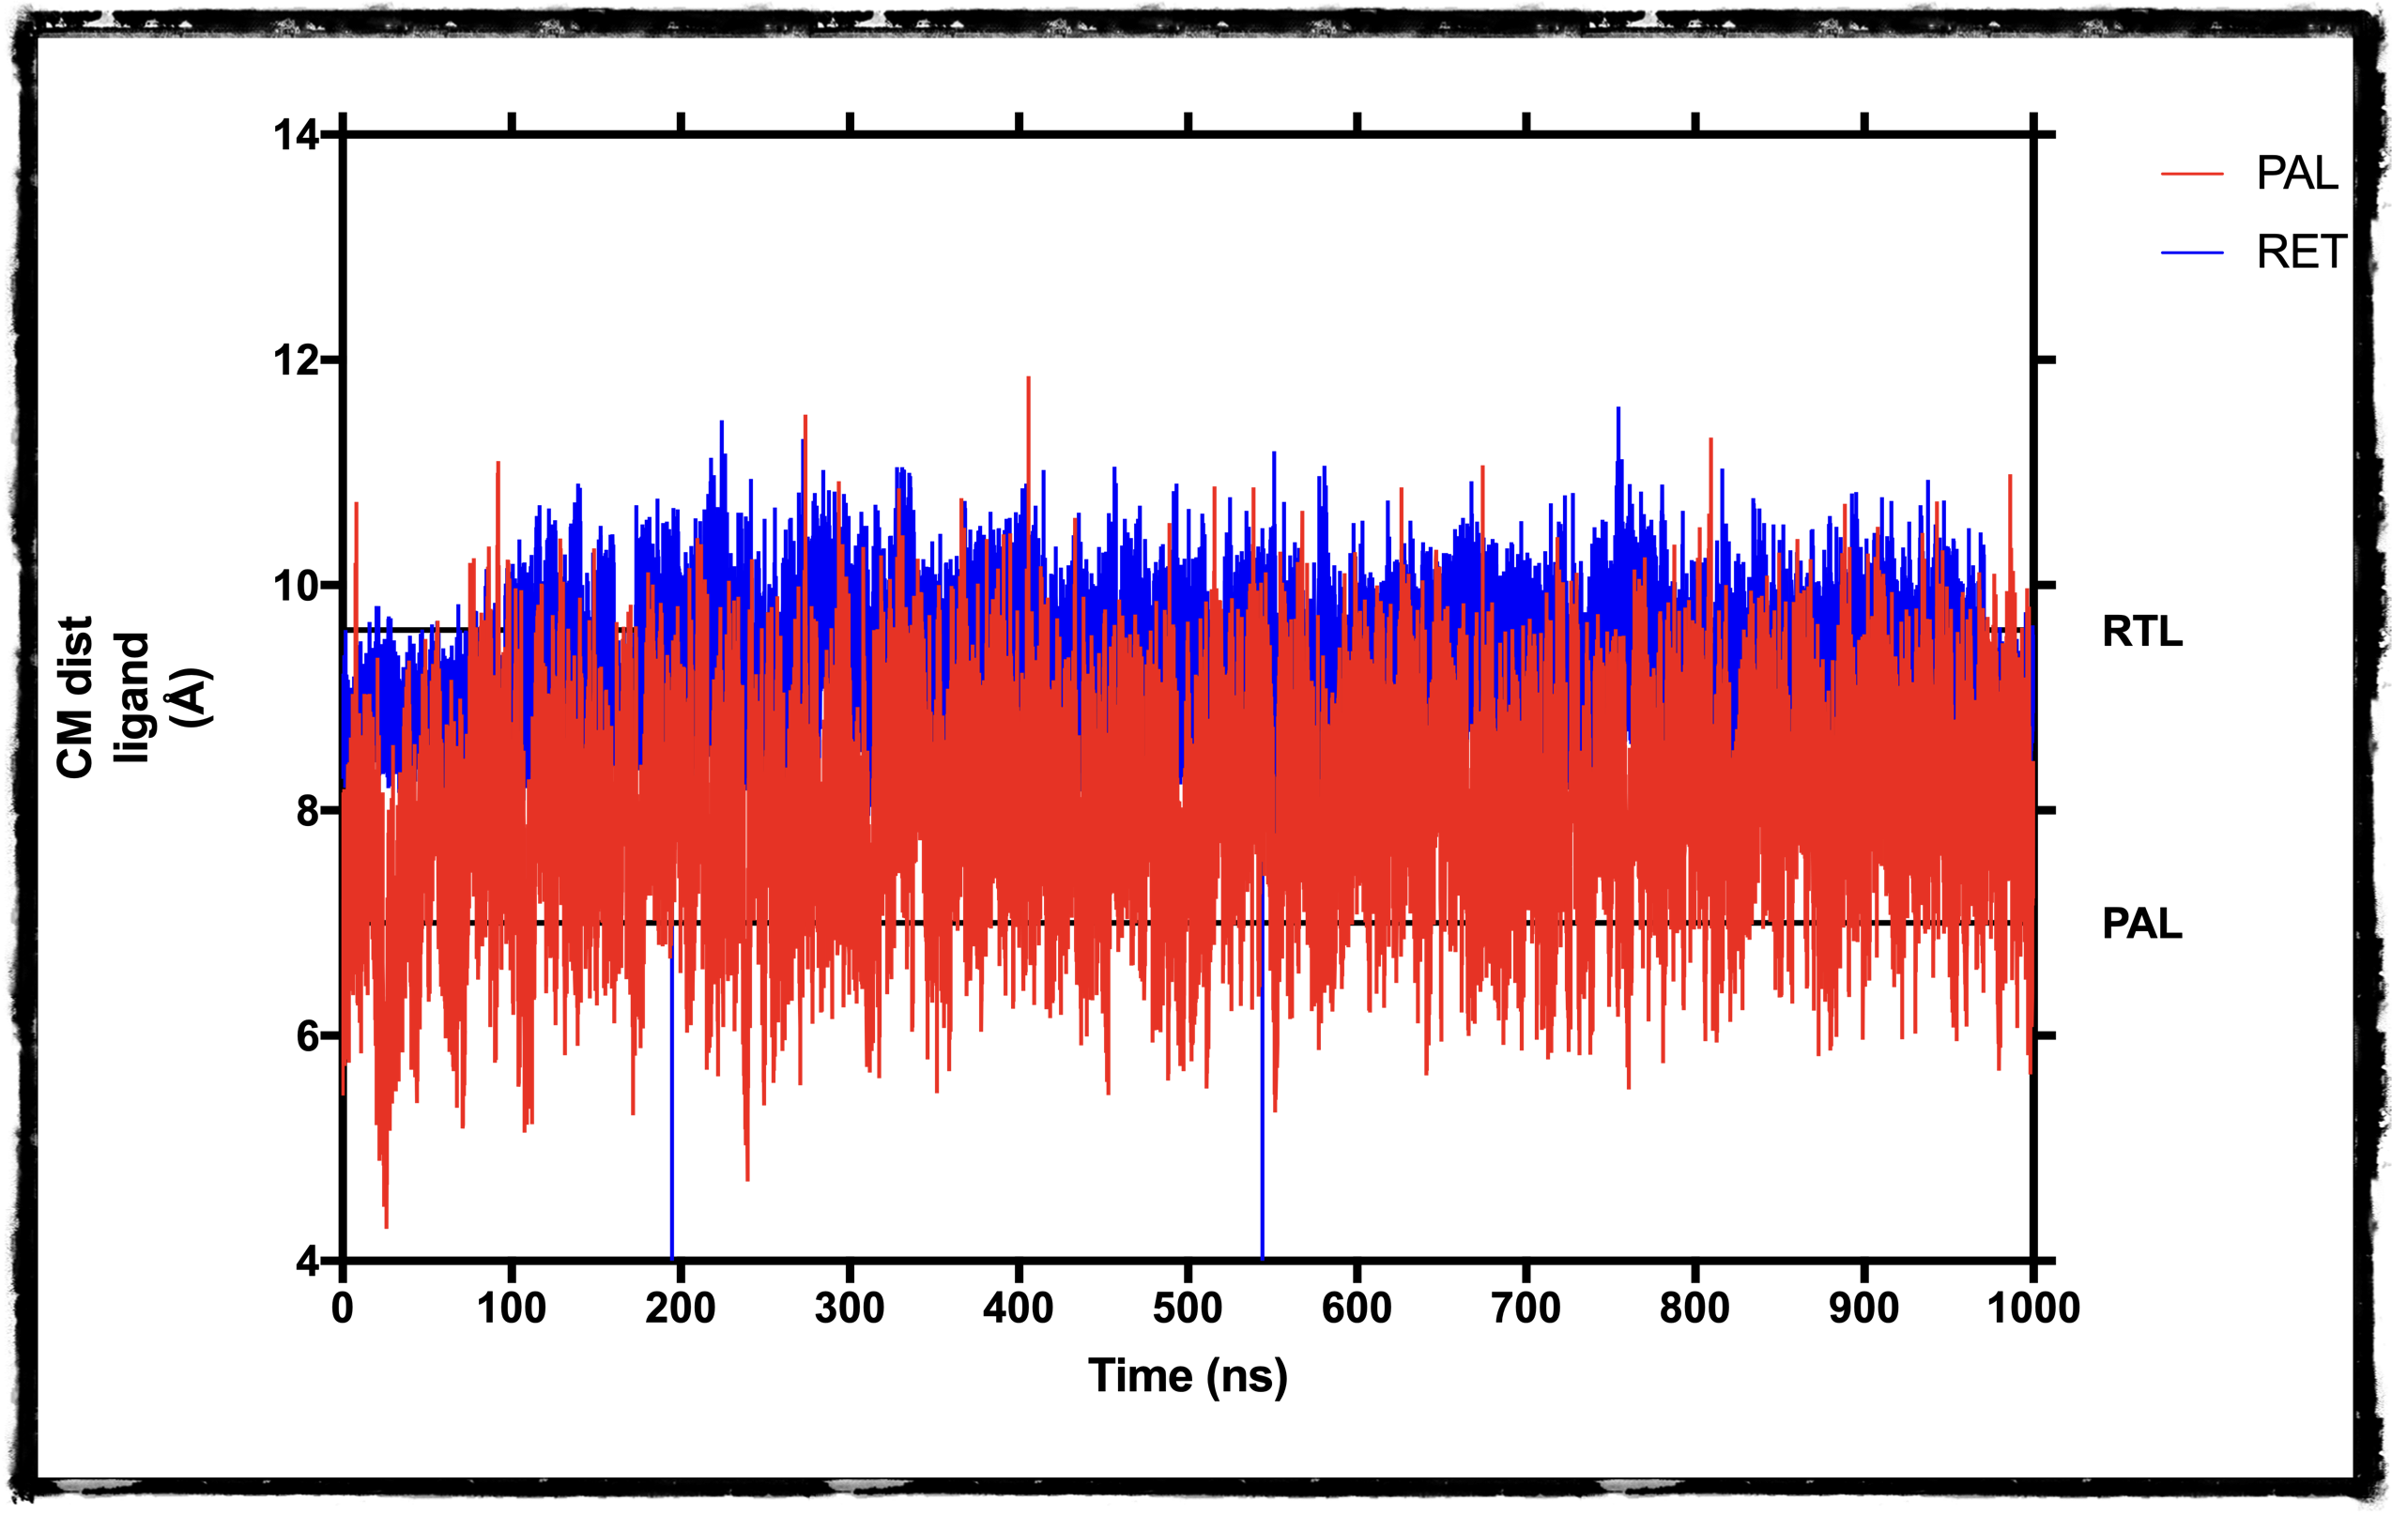
Ligand position: ligand-F105

Slide 14
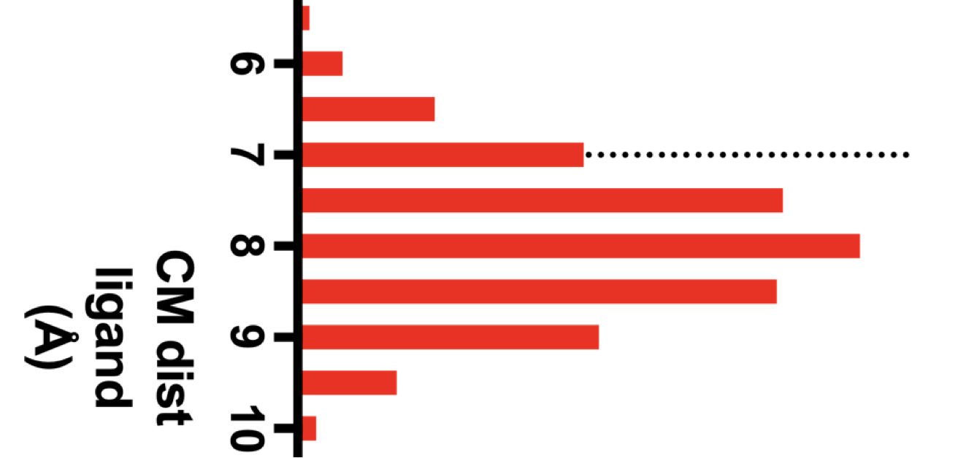
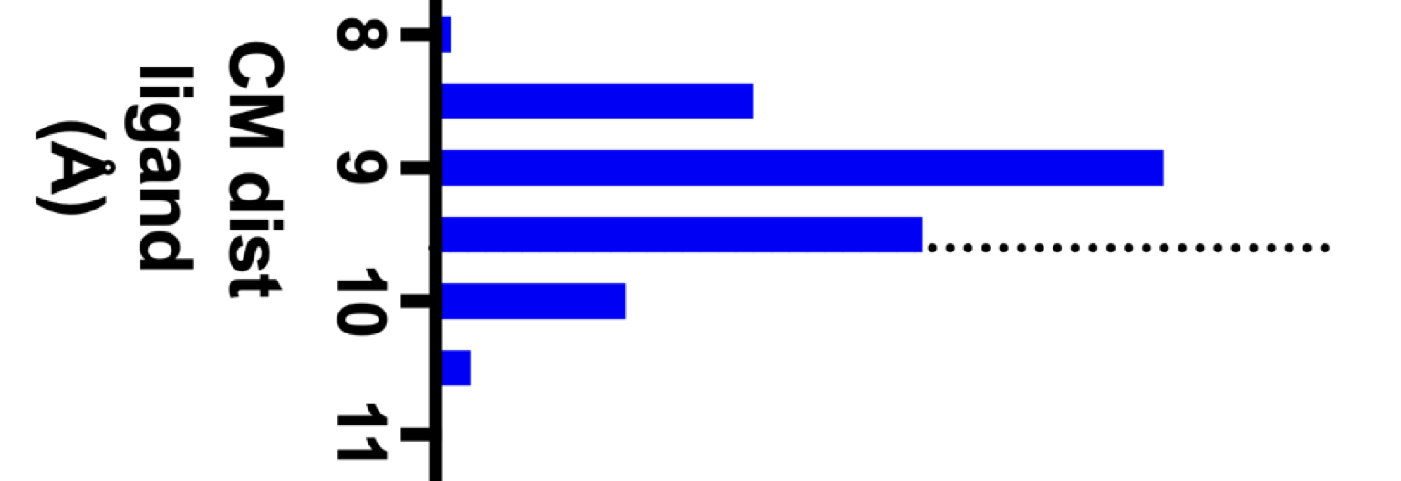
Ligand position: ligand-F105

Slide 15
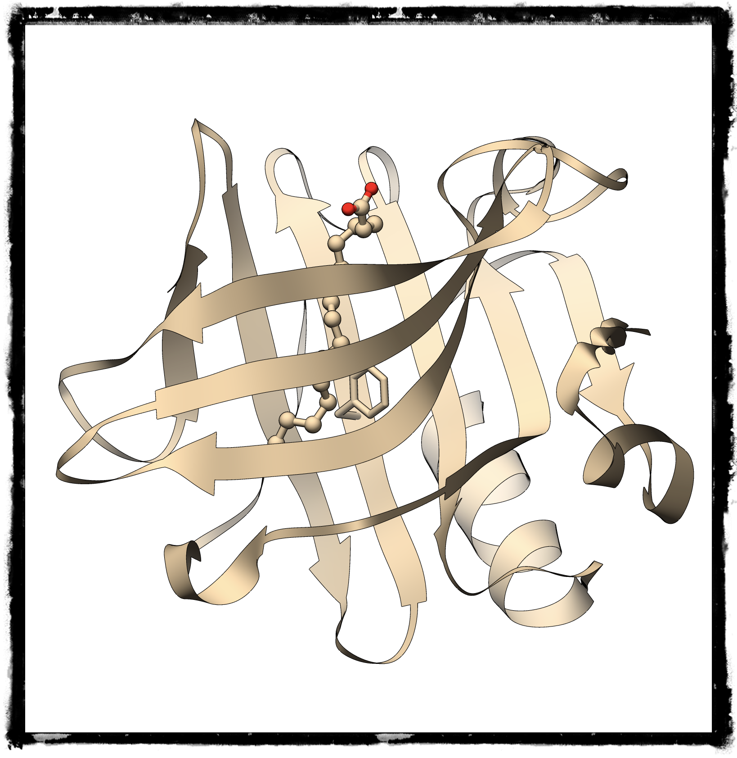

F105

Slide 16
F-105 dihedrals as a function of ligand

Slide 17
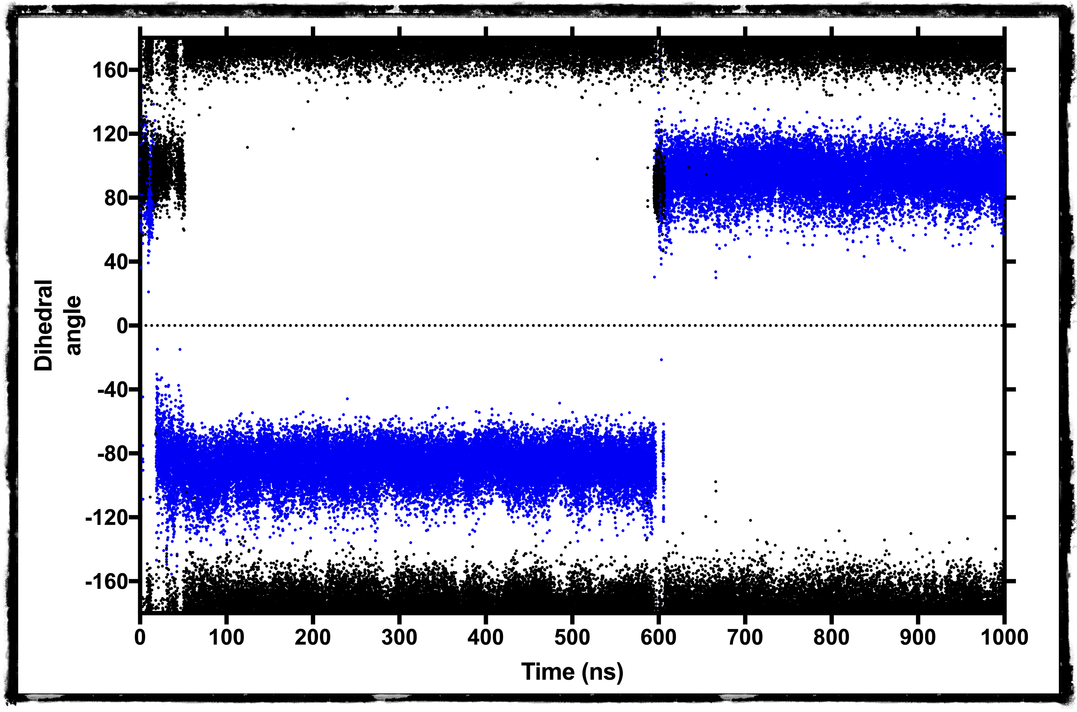
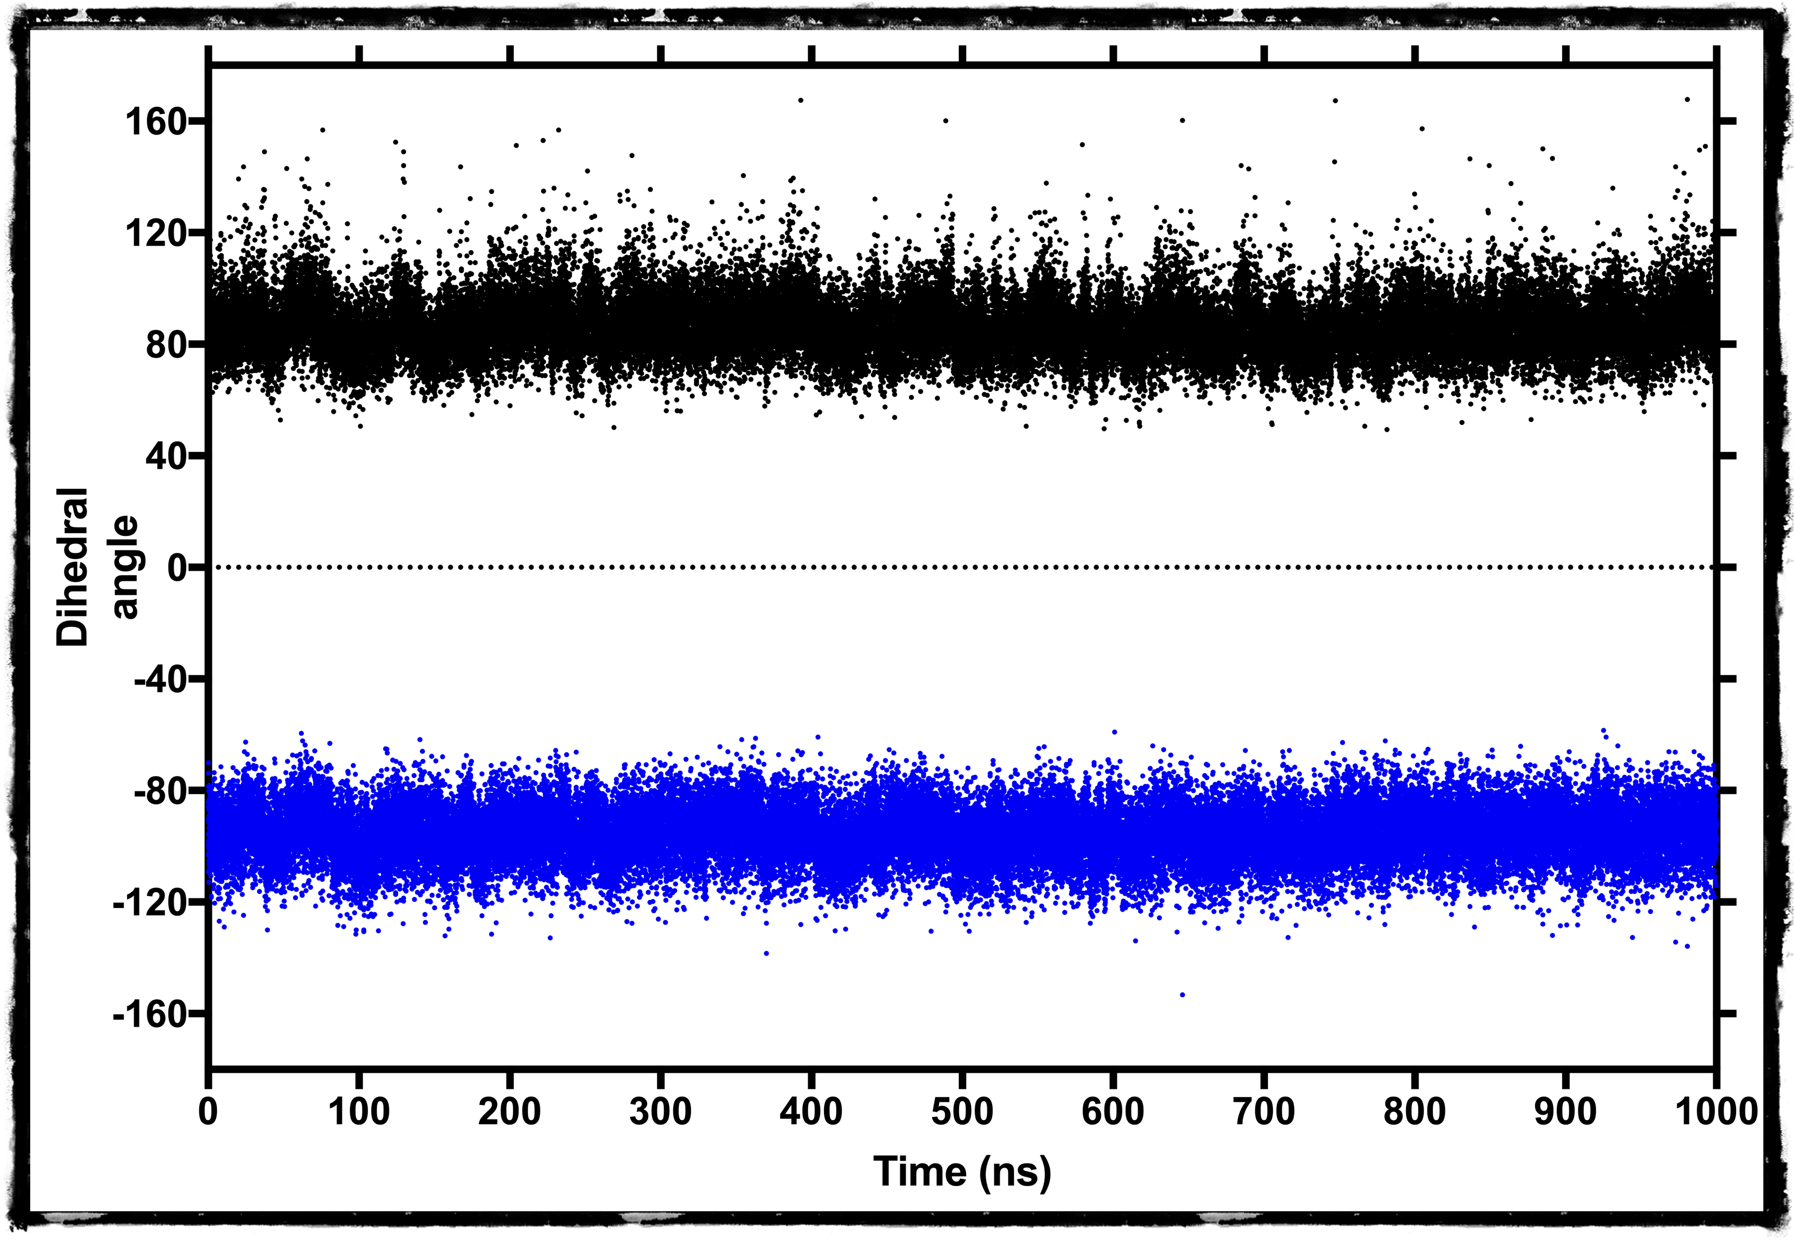
what about ligand entry?

Slide 18
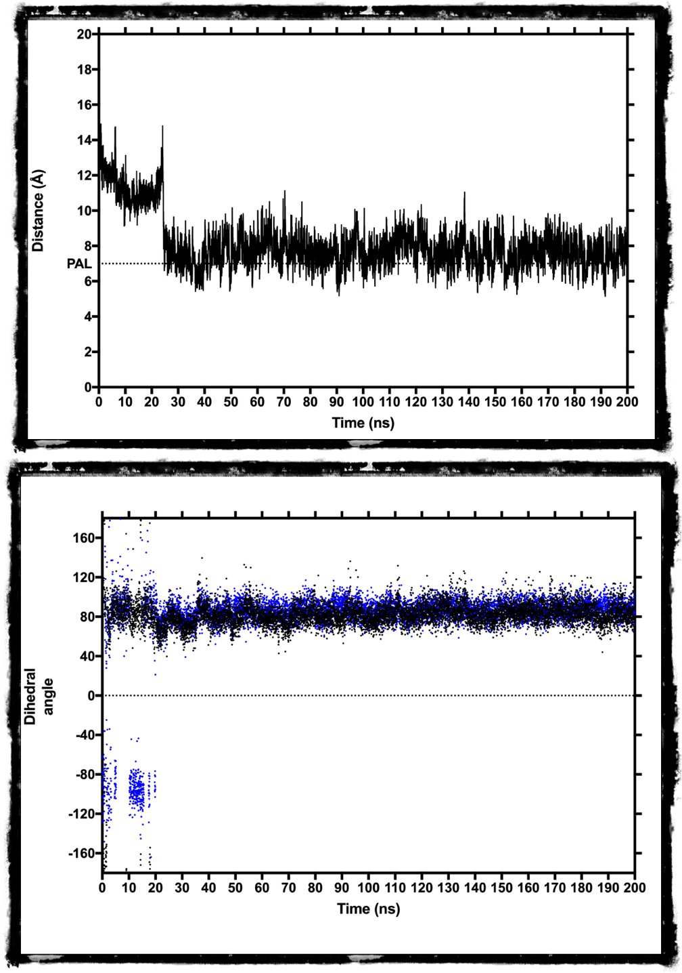
what about ligand entry?

Slide 19
The dynamics of F105 change depending on the ligand.
On MD, binding (once a ligand is located near the entry of the binding site) is in the tens of nanosecond regime.

